Slide 1
Addressing Modes
The term addressing modes refers to the way in which the operand of an instruction is specified. The addressing mode specifies a rule for interpreting or modifying the address field of the instruction before the operand is actually executed.
Thus, the different ways of specifying the instruction are called as addressing modes:
Implied/ Implicit Addressing Mode
Stack addressing Mode
Immediate Addressing Mode
Direct Addressing Mode
Indirect Addressing Mode
Register Direct Addressing Mode
Register Indirect Addressing Mode
location of an operand in an
Implied Addressing Mode: In this addressing mode, the definition of the instruction itself specify the operands implicitly. It is also called as implicit addressing mode.
e.g.
The instruction “Complement Accumulator” is an implied mode instruction (CMA).
In a stack organized computer, zero address instructions are implied mode instructions.

Slide 2
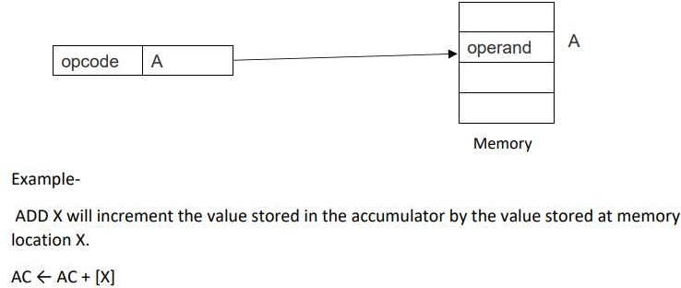
Stack Addressing Mode: In this addressing mode, the operand is contained at the top of the stack.
e.g. ADD
This instruction simply pops out two symbols contained at the top of the stack. The addition of those two operands is performed.
The result so obtained after addition is pushed again at the top of the stack.
Immediate Addressing Mode: In this addressing mode, the operand is specified in the instruction explicitly. Instead of address field, an operand field is present that contains the operand.
e.g. ADD 100 will increment the value stored in the accumulator by 10. MOV R #20 initialized register R to a constant value 20.
Direct Addressing Mode: In this addressing mode, the address field of the instruction contains the effective address of the operand. Only one reference to memory is required to fetch the operand. It is also called as absolute addressing mode.

Slide 3
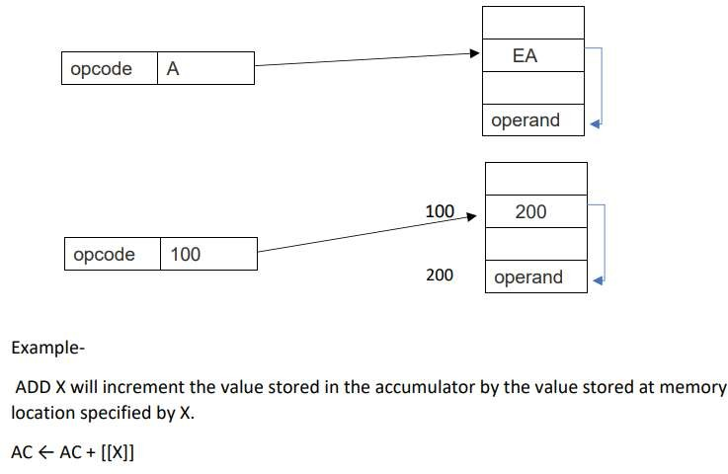
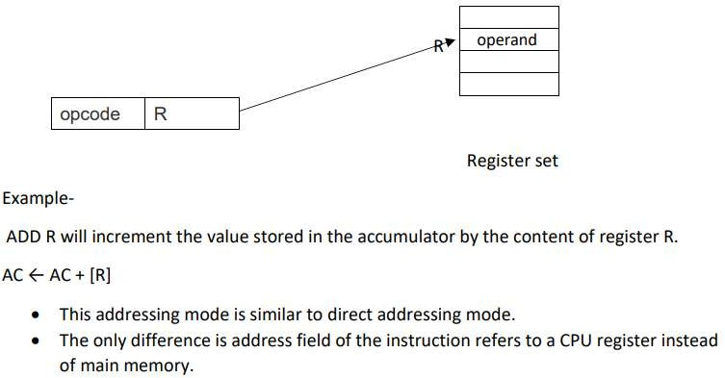
Indirect Addressing Mode: In this addressing mode, the address field of the instruction specifies the address of memory location that contains the effective address of the operand. Two references to memory are required to fetch the operand.
Register Direct Addressing Mode: In this addressing mode, the operand is contained in a register set. The address field of the instruction refers to a CPU register that contains the operand. No reference to memory is required to fetch the operand.

Slide 4
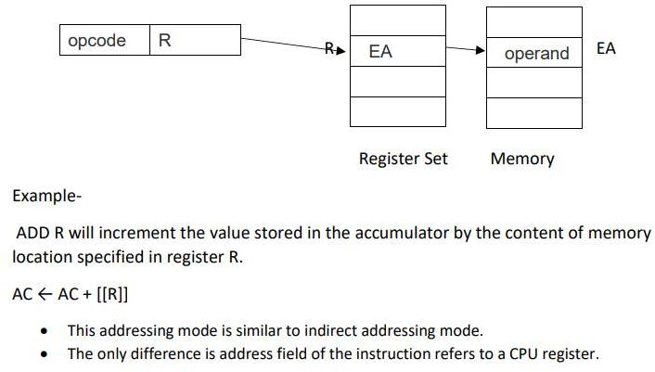
Register Indirect Addressing Mode: In this addressing mode, the address field of the instruction refers to a CPU register that contains the effective address of the operand. Only one reference to memory is required to fetch the operand.

